Slide 1
Project Growing Minds Website
Notes:
www.projectgrowingminds.com

Slide 2
WELCOME TO PROJECT GROWING MINDS
This website was designed for teen girls like you. We want to show you how your mindset, or the way you view your intelligence and abilities, can make a big difference in your performance in school. We’ll start by explaining what mindsets are and then give you information about how having a growth mindset can help you succeed. You’ll even get tips for fostering a growth mindset from college students who understand the challenges you face as high school students. By the end, we hope you will have learned that MINDSETS MATTER!
Instructions: Please move through each section in order making sure to complete all four steps before moving on to the next section.
CLICK HERE TO BEGIN
Notes:
HOME PAGE

Slide 3
Introduction
The goal of this section is to introduce you to the concept of mindsets. Complete Steps 1-4 in order. Once you have finished, continue on using the button at the end of Step 4. Remember, make sure to complete the activity so we can assure you participated in all components. To see each section, click on the image.
STEP 1
STEP 2
STEP 3
STEP 4
CLICK HERE TO EGIN
Notes:
Introduction main page

Slide 4
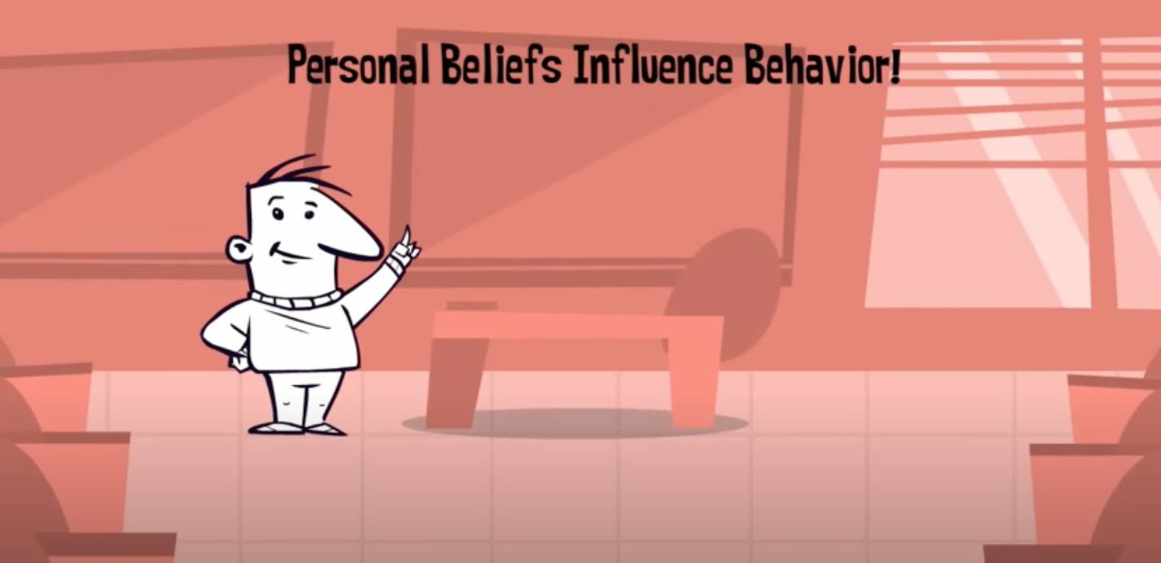
Introduction
CLICK HERE TO EGIN
Notes:
Introduction: Step 1 page (teaching video)
Video link: https://youtu.be/5Jr3vqojN-A

Slide 5
CLICK HERE TO EGIN
Notes:
Introduction: Step 2 page (article)
Article is saved in .ppt file as an Acrobat Document Object. Right click, select “Acrobat Document Object”, then “Open,” to open in Adobe Reader.

Slide 6
VIDEO CONTENT:
My name is. (pause)
I am currently an undergraduate student at North Carolina State University. Students often wonder how to do well in high school. One important thing to understand as a student is that the talent myth is pretty much bogus. You have to just immerse yourself in the material, live it, discuss it, ask questions, and then do it some more. Take all the time you need to complete the assignments well and really learn the material . Don’t be intimidated by people who seem to do things faster. Completing work fast doesn’t mean people are better at it.
Taking longer often means that people are learning the material more deeply.” I take plenty of time to get my work done; often longer than my peers. I really like that Albert Einstein said he wasn’t smarter than other people, he just spent longer on things!
Notes:
Introduction: Step 3 page (student tip)
Link to student tip video: https://youtu.be/Dk7P4hw6-gE

Slide 7
Please enter your full name:
What was the main theme of the article you read?
You might be thinking, “Aren’t some students just better at school than I am?” And, when you face a challenge, you might think, “Well, I am just not good at school.” If you can remember that everyone can learn new things, you can change your mindset and overcome challenges. What is your own mindset? Do you think that some people are just talented in school whereas others are not?
What is your own mindset? Do you think that some people are just talented in school whereas others are not?
There is evidence that debunks this talent myth. Data tells us that there are no shortcuts to success—everyone has to practice a lot to become an expert—10,000 hours in fact!
Continue to Intelligence Mindset
CLICK HERE TO EGIN
Notes:
Introduction: Step 4 page (activity)

Slide 8
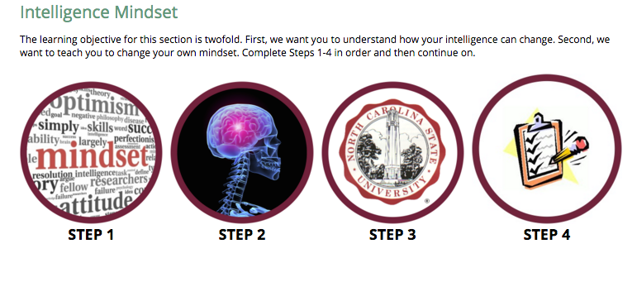
Notes:
Intelligence Mindset Page

Slide 9
Intelligence Mindset
Notes:
Intelligence Mindset: Step 1 Page (Teaching video)
Video Link (Also embedded in slide): https://www.youtube.com/watch?v=6vdeCIfWppY

Slide 10
Intelligence Mindset
Notes:
Intelligence Mindset: Step 2 Page (teaching video)
Video Link: https://www.youtube.com/watch?v=XcnVg2QUxLI

Slide 11
Intelligence Mindset
Notes:
Intelligence Mindset: Step 3 Page (Student tip)
Video Link: https://www.youtube.com/watch?v=NOSQda2gwRk

Slide 12
Intelligence Mindset
Notes:
Intelligence Mindset: Step 4 Page (activity)

Slide 13
Self-Control Mindset
Notes:
Self-Control Mindset Page

Slide 14
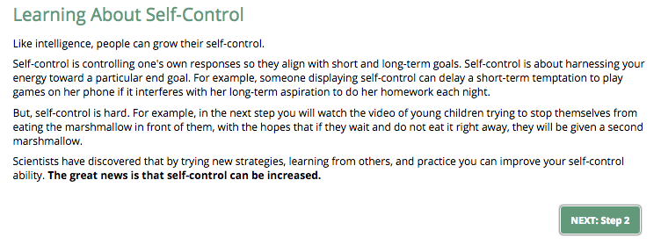
Self-Control Mindset
Notes:
Self-Control Mindset: Step 1 Page (teaching)

Slide 15
Self-Control Mindset
Notes:
Self-Control Mindset: Step 2 Page (teaching video)
Video Link: https://www.youtube.com/watch?v=QX_oy9614HQ

Slide 16
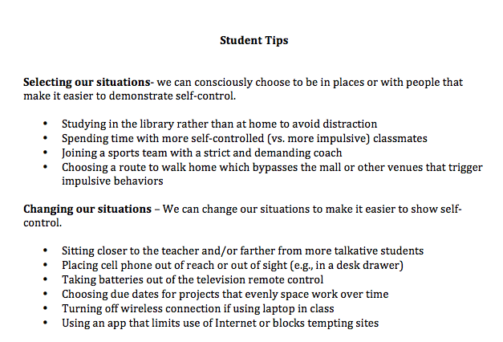
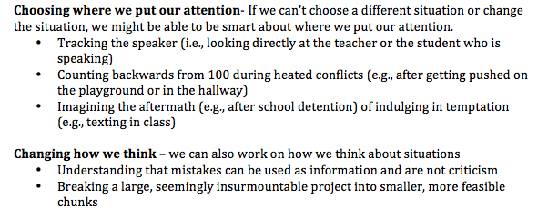
Notes:
Self-Control Mindset: Step 3 Page (Student tip)
Word file that opens when the Step 3 icon is clicked.

Slide 17
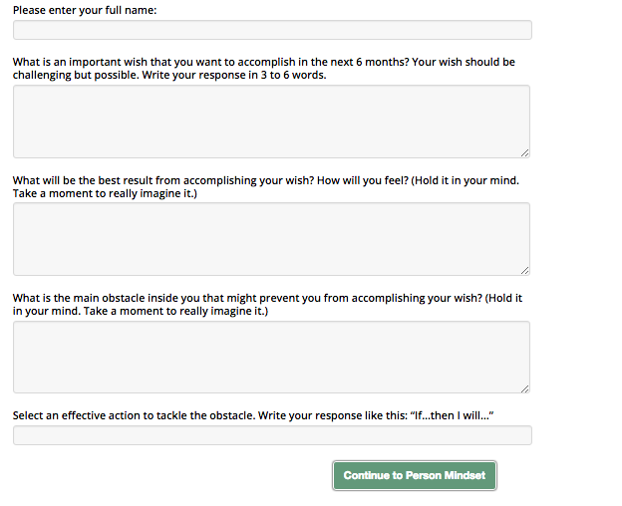
Self-Control Mindset

Slide 18
Person Mindset
Notes:
Person Mindset Page

Slide 19
Person Mindset
Notes:
Person Mindset: Step 1 Page (Teaching Page)

Slide 20
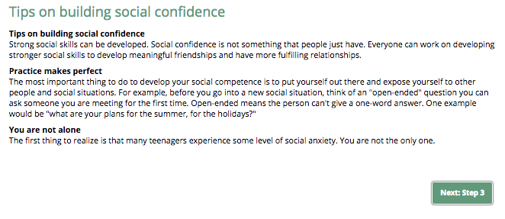
Person Mindset
Notes:
Person Mindset: Step 2 Page (Tips)

Slide 21
Person Mindset
Notes:
Person Mindset: Step 3 Page (Student Tip)
Video Link:

Slide 22
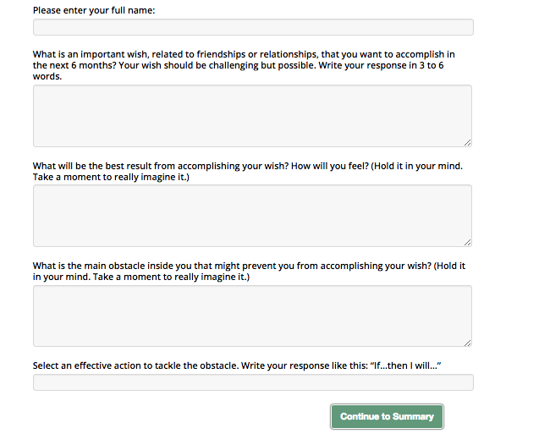
Person Mindset
Notes:
Person Mindset: Step 4 Page (Activity)

Slide 23
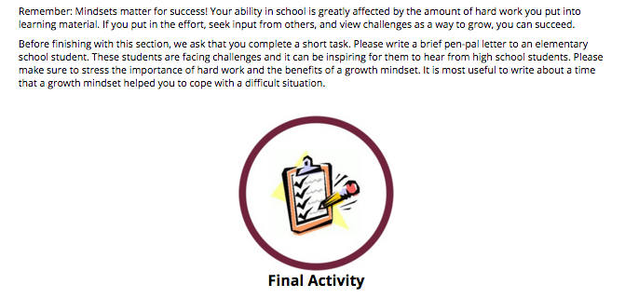
Summary
Notes:
Summary Page

Slide 24
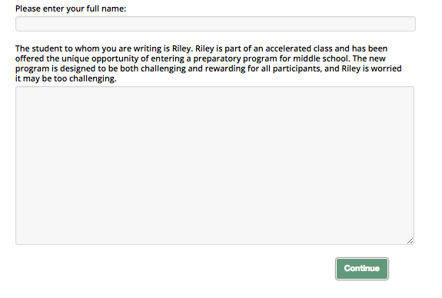
Summary
Notes:
Summary Page: Final Activity

Slide 25
Notes:
Final Page

Slide 26
Logo for Homepage
Notes:
Logo 1

Slide 27
Logo for Tab 1
Notes:
Logo 2

Slide 28
Logo for Tab 2
Notes:
Logo 3

Slide 29
Logo for Tab 3
Notes:
Logo 4

Slide 30
Logo for Tab 4
Notes:
Logo 5

Slide 31
Logo for Tab 5
Notes:
Extra Logo

