Slide 1
Healthy Minds Intervention

Slide 2
Welcome! We are so glad you are here! You will be working through the HEALTHY MINDS program. In this program, you will learn more about the ways people and emotions change. We will discuss how this relates to COVID-19 and mental health. We will ask for feedback on the program—we really appreciate your help. A couple of things to keep in mind as you move through the program: Please complete the entire program at one time. If you don’t, your data will disappear and you will have to start over. The entire program should take you about 30 minutes to complete. You will begin with a pre-survey, which will take about 5 minutes to complete. Next, you will complete the Healthy Minds program, which will take between 15-20 minutes to complete. Finally, you will complete a post-survey, which will take about 5 minutes to complete. IMPORTANT: After completing the post-survey, you will get a code. You will need this code in order to receive your $5 gift card. Okay, let’s get started. You will start off by reading about challenges before learning about mindsets!

Slide 3
What are mindsets, you may ask? Mindsets are beliefs people have about their traits and abilities. Those traits may include things such as intelligence, athletic ability, emotions, and so much more. They also affect the strategies people use when facing challenging situations. There are two types of mindsets:
Fixed mindset: The belief that people are born with certain traits and abilities, which are unchangeable.
Growth mindset: The belief that people can develop their traits and abilities over time and can change.

Slide 4
So, how can you help us today?
Please look at everything carefully and learn about some things that science has to say about how people change! You will read about the brain and watch some videos about real-life people. You’ll also be asked to provide advice to other students and write down what you might do if you were in that situation.

Slide 5
Are you stuck being one kind of person?
Is it actually true that people can change?
Brain scientists have discovered that people do things because of the thoughts and emotions that they have—and all of these thoughts and feelings live in the brain.

Slide 6
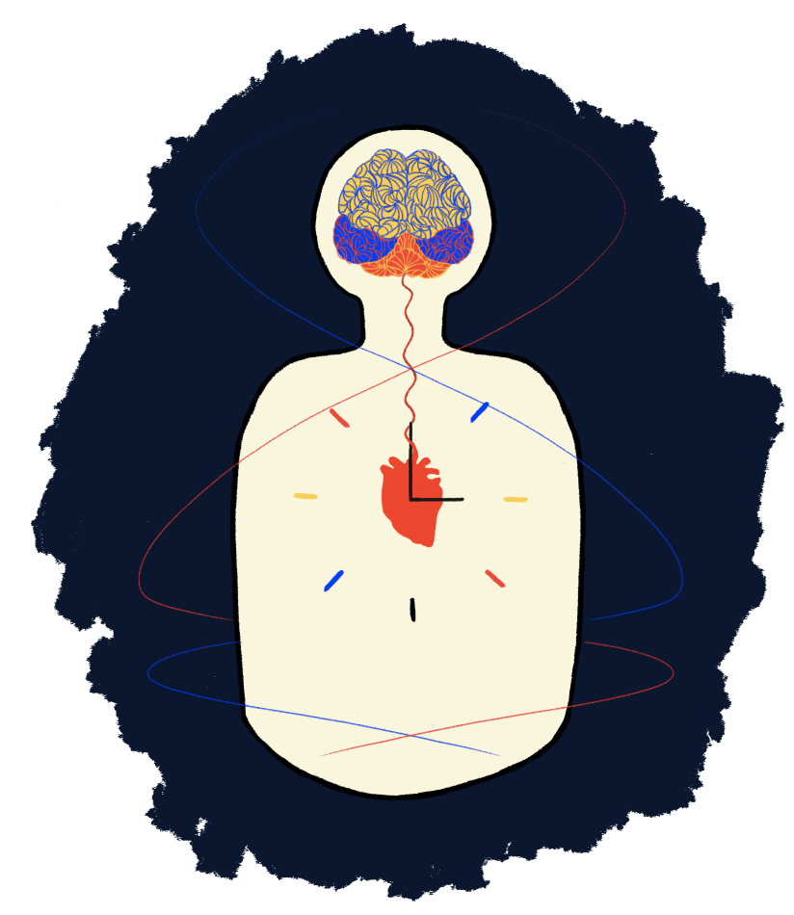
When you have a THOUGHT,
like “I am a shy person,” or a
FEELING, like happy, sad, or
scared, the building blocks of
your brain, called NEURONS,
start talking to each other.
When neurons talk to each other like this,
they form CONNECTIONS, which lead to
your actions.
When neurons make NEW
connections with each other,
people’s personalities and
emotions can change. People
can respond better and with different
emotions.
And so people aren’t stuck being a certain type of person such as “lonely,” or “mean" or "unhappy". Neurons can ALWAYS make new connections and these connections lead to change.
One key to success is to remember that you should never blame yourself for the emotions you feel because everyone’s brain is a “work in progress.”

Slide 7
How do we know that people's personalities and emotions live in the brain?
One way scientists know that
personality and emotion lives in the
brain is because when people’s
brains get hurt, their personalities
and emotions actually change!
Here’s an amazing example.

Slide 9
Video 2
https://youtu.be/imxFYEFfpIo

Slide 10
Imagine you have a good friend that you’ve been talking to using Zoom while learning at home. Many times, when you talk to your friend, they seem sad, mean, and they aren’t participating in many of the activities they usually enjoy. However, when it is safe to return to school and you see them, they seem much happier and kinder. They get involved in the activities they love.
Why do you think these changes might have happened? When writing your answer, think about what you have learned so far about changing emotions, personality and the brain
Please write 2-3 sentences in the box below.

Slide 11
Scientists say the connections between neurons in your brain are made with a pencil, not a permanent marker.
Of course, changing your brain connections isn’t as easy as just erasing a pencil drawing. It can take a lot of practice and work on your part. But with the right help, anyone can change over time.

Slide 12
Because brain connections are written in pencil, not permanent marker, people can change. Someone who is very lonely today might be less lonely later. Someone who feels sad or gloomy might become happier over time. And someone who acts mean or causes drama may not always be that way when they grow different connections in their brain.
People can successfully learn different ways of acting. And when they do this, they can actually change the connections in their brain.

Slide 13
So, now we know people can change...but why do they?
Several things can happen.

Slide 14
Why do people change? Here are three things science says are possible:
People get more comfortable in a new school.
People can become less mean when they feel like they have less to prove.
People can become less shy when they feel more relaxed in a new place.
People learn new ways of thinking or learn new skills.
People may learn how to cope with hard times that lead to negative emotions.
With these new strategies of how to cope, they learn to manage their emotions.
People make new relationships and friendships.
People may feel more connected and less lonely.
Then, they end up feeling less worried and happier.
Source: NCVS, 2011; Loneliness: Human Nature and the Need for Social Connection, 2008; Child Development, 2013

Slide 15
HOW do people change?
They focus on the process, not the outcome!
Over time, your brain will continue to grow and develop as you learn new skills and try new things.
At first, the people who are successful at changing are focused on what they need to do to get there. They realize there are a lot of reasons people struggle, and most have nothing to do with the self. They understand that they just aren't there YET - but it is possible!
They view challenges as a chance to learn.
People who successfully change understand that difficulties often get in the way of their goals; but these challenges are just an opportunity to learn new skills and strategies for how to handle the challenges and continue towards their goal. With these new strategies of how to cope, they learn to manage their emotions.
When you find new ways to handle challenges your brain can start to make new connections.
They remember that people and situations can change.
When people change, they have to remind themselves that it is possible. Nothing is permanent! People can change their thoughts, feelings, and behaviors. Situations can change too!
Source: NCVS, 2011; Loneliness: Human Nature and the Need for Social Connection, 2008; Child Development, 2013

Slide 16
Video 3
https://youtu.be/a9oJ1wnjsms

Slide 17
Let's take a second to review.
We learned that we can shape our thoughts and feelings, and that can change our brains and behaviors. Our brain connections are like they’re written in pencil—it’s possible to change them. That’s why people who act shy can become more outgoing, and people who act mean can become kinder.
We also learned that people change because of being in new places, making new friends, and learning new ways of thinking. People don't need to blame themselves for having negative emotions, and instead they can use new feelings and experiences to make a change.

Slide 18
Now, we need your help.
We need your help to teach other students like you that even when they struggle and have strong emotions, they should remember that it won’t last forever—because people can change.

Slide 19
First, we ask that you read results from a survey about social experiences in school and read some stories from other students.
Second, we ask for you to write your own ideas.

Slide 22
Now that you’ve read other students’ stories, we would like you to share
your own story and advice.
We’ll be using your stories to help other new students in middle school
and high school deal with some of the same issues you may be experiencing.

Slide 23
Imagine it is your first day back in school after virtual learning. When you are hanging out by your locker, you see one of your good friends from last year. You don't know too many other people in your grade, so you say hello to him and smile. But instead of saying hello back to you, he turns around and walks the other way. He starts talking to a couple of other classmates nearby.
How do you think you would feel if this happened to you? What kind
of thoughts do you think you would have?
Please write 2-3 sentences in the box below.

Slide 24
2. Now imagine that the same event you just talked about happened to another person just like you. That is, imagine another person tried to say hello to a friend for the first time after coming back to school, only to have that person turn around and walk away.
What could you say to help them understand that they can change, or that the things that are happening to them could change? When deciding what you want to say, think about what you learned today about changing emotions, personality and the brain.
Please write 2-3 sentences in the box below.

Slide 25
Now, let’s write a story!
It is not unusual for people to experience stressful and upsetting events that have meaningful effects on our lives. The global COVID-19 pandemic, for example, has caused many people to experience large changes in their lives, as well as more challenges and stresses. We are interested in knowing more about the effect of COVID-19 on you and your life. To best understand your experience, we would first like to ask you to please think about an event that best explains the challenges you have faced as a result of COVID-19.
Once you identified this event in your mind, please write everything you remember about this event, including:
What happened
Who else (if anyone) was involved
What you thought and felt during the event
Why you chose to write about this particular event
What this event says about who you were, who you are, and who you might be
Date each memory (month/year) as accurately as you can, even if you must estimate. If the memory extended over a period of time, please report the middle of the period.
Please write as detailed a description of the event so that we can have a sense for what you went through and what it felt like to you. You do not have to write your description in the order listed above. Instead, think of it like a story, where you have a beginning, middle, and end. Do not worry about spelling, sentence structure or grammar. Everything you write is entirely confidential. Take as much time and space as you need.
Source: OSF Registration: College, Interrupted: Individual differences in freshmen college student mental health, identity, and retention in college as a function of COVID-19 disruptions to education across four institutions. Monisha Pasupathi, Kate C. McLean, Jordan Ashton Booker, Cecilia Wainryb, Robyn Fivush, Andrea Greenhoot, Mikayla Ell, Maia Lynn Southwick, Tracy Phan, and Robyn Kelton

Slide 26
Why Did You Ask Me to Write a Story?
Research has shown when you write a story with the following parts, it can improve your mental health:
Agency: Feeling like you are in control of your life
Communion: Feeling like you have good relationships in your life
Coherence: Telling the story in a way that connects
Redemption: When the story starts out on a low note, but ends on a high note
Narratives help us make sense of new events and our experiences. Now, we want to share some tips on how to change your own narrative in ways that may help you feel better.

Slide 28
Bringing It All Together
Now, take a look at the story you wrote and examine it for agency, communion, redemption, and coherence. Are there any sections you could rewrite now? If not, that’s ok too. Just keep these things in mind as you try to make sense of the way you approach challenges in your life. Remember, change is a process that takes time, and we are all learning.
Note: You can choose to rewrite your story if you wish, but it is not required. If you decide not to rewrite it, take some time to think about what you might change next time.

Slide 29
Final Thoughts: What Did You Learn?
In the space below, please answer the following questions:
1) What have you learned after taking this program?
2) Why does the way you tell stories about life events matter?

Slide 30
COVID-19 and Mental Health Resources
Thank you for participating! If you’re ever struggling, please remember: You are not alone! There are lots of resources in your area and online that are meant to help you on hard days. Some of them include: Your school counselor - reach out anytime to make an appointment! Hope4NC Crisis Counseling (1-855-587-3463, https://www.sandhillscenter.org/hope4nc)
​​​​Provides anonymous mental health counseling services, referrals and resources. Can help with COVID-related stress responses such as irritability, fear, substance use, and a desire to decrease chronic stress.
Crisis Text Line (Text "TALK" to 741-741)
Text with a trained crisis counselor for FREE, 24/7.
This is a great resource for anyone who prefers texting over calling, or does not have private time to talk on the phone.
You can find many more resources by clicking on the following link: https://teenhealthncsu.wixsite.com/website. You are welcome to use this webpage at any time! Lots of people use these services, and they can be really helpful.

Slide 31
You have now completed the HEALTHY MINDS program! We hope you learned a lot while participating in the program. Remember, there are many resources to help you through difficult times. Those resources can take many different forms. Sometimes, those resources include ‘rewriting’ the event. Other times, we need to rely on websites, other people, etc. Everyone needs different resources and that’s ok!

